Slide 1



FAST TAG FRAUD DETECTION
Become an inferencing detective today!

Slide 2






problem statement
This project focuses on leveraging machine learning classification techniques to develop an effective fraud detection system for Fastag transactions. The dataset comprises key features such as transaction details, vehicle information, geographical location, and transaction amounts. The goal is to create a robust model that can accurately identify instances of fraudulent activity, ensuring the integrity and security of Fastag transactions.

Slide 3



dataset description
1. Transaction_ID: Unique identifier for each transaction.
2. Timestamp: Date and time of the transaction.
3. Vehicle_Type: Type of vehicle involved in the transaction.
4. FastagID: Unique identifier for Fastag.
5. TollBoothID: Identifier for the toll booth.
6. Lane_Type: Type of lane used for the transaction.
7. Vehicle_Dimensions: Dimensions of the vehicle.
8. Transaction_Amount: Amount associated with the transaction.
9. Amount_paid: Amount paid for the transaction.
10. Geographical_Location: Location details of the transaction.
11. Vehicle_Speed: Speed of the vehicle during the transaction.
12. Vehicle_Plate_Number: License plate number of the vehicle.
13. Fraud_indicator: Binary indicator of fraudulent activity (target variable).

Slide 4

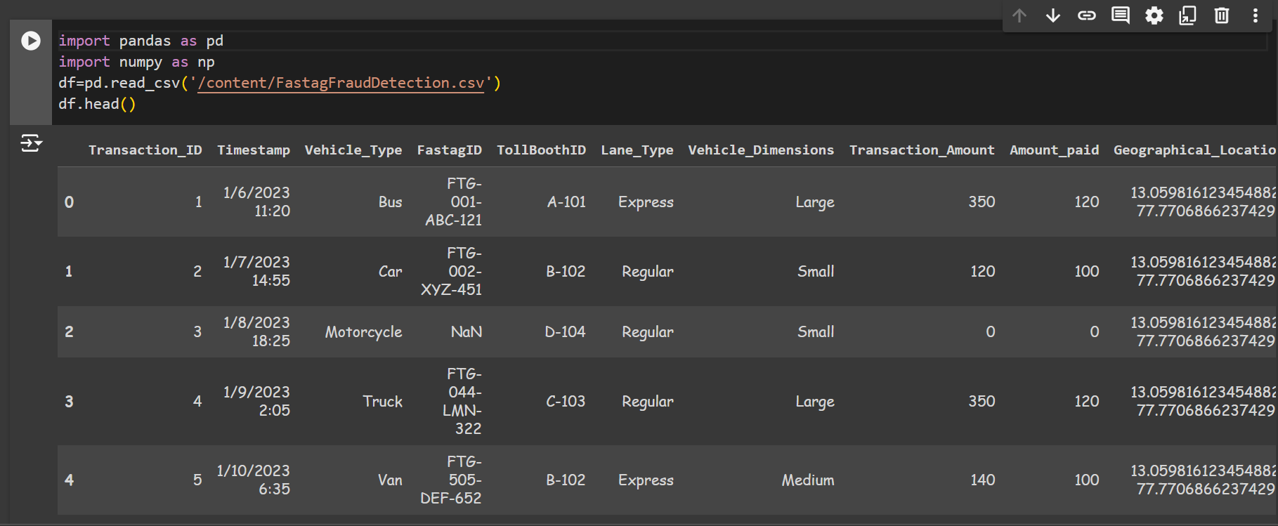

Slide 5


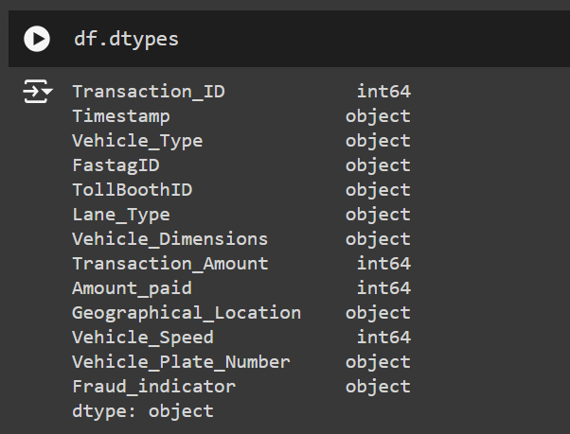

data info
data exploration
going through the data given to know the data types of each column.

Slide 6
data preprocessing
by removing the rows that have missing values or null values.
handle null values
handle outliers
No outliers are present in the any of the columns of the given data.

Slide 7
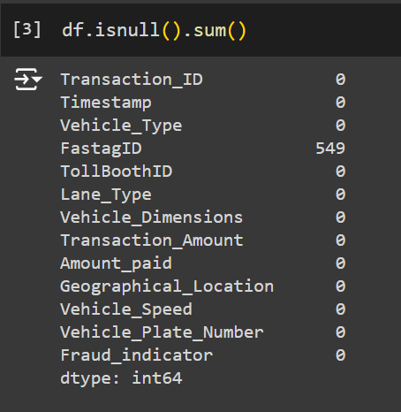
null
values
handling

Slide 8
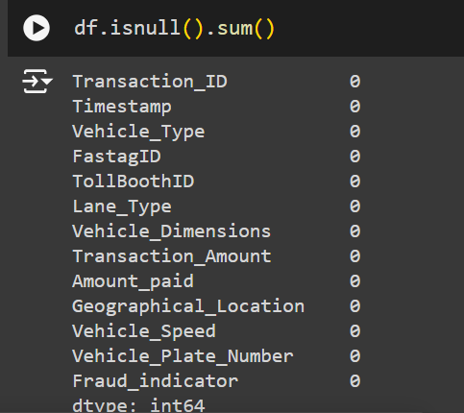

drop the rows to handle the
null values according to data

Slide 9

feature
engineering
It is the the process of creating new features or transforming existing features to improve the performance of a machine-learning model.

Slide 10

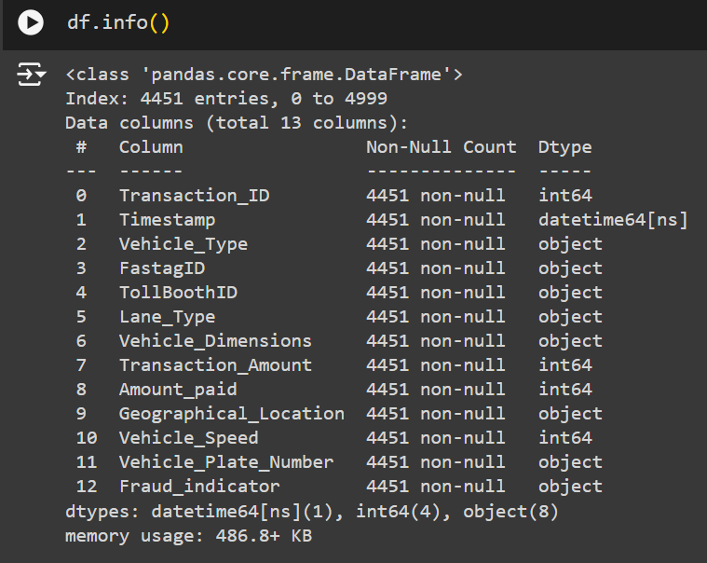
converting the datatype of timestamp column from object to datetime
after converting the datatype of timestamp column to datetime

Slide 11
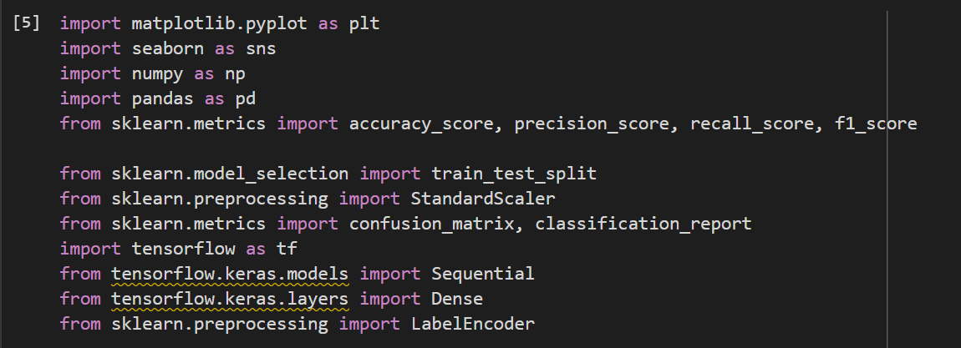
model development
Here we will train the model on the data and evaluate the metrics of the model
import all the required libraries first

Slide 12
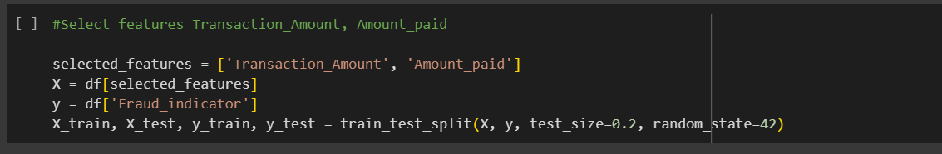
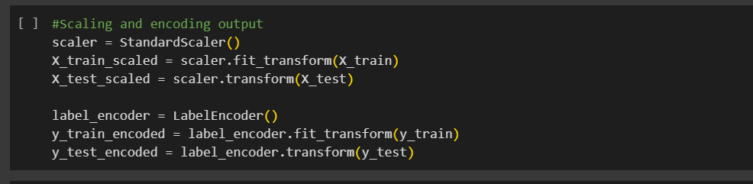
Using Neural network

Slide 13
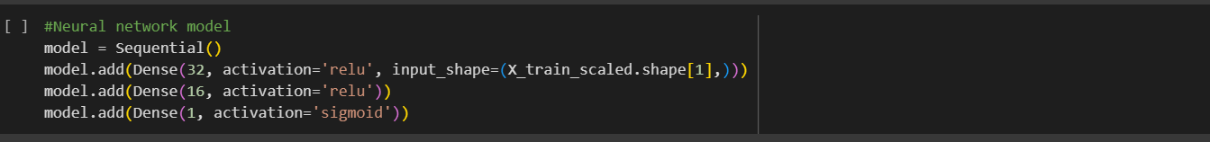
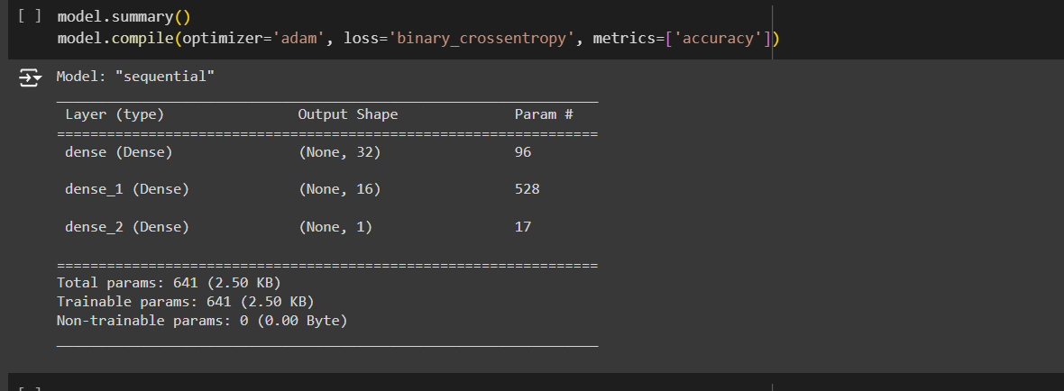

Slide 14
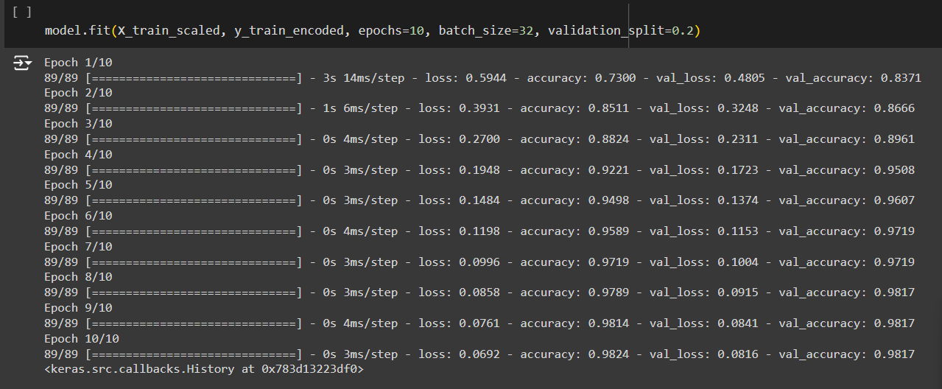

Slide 15
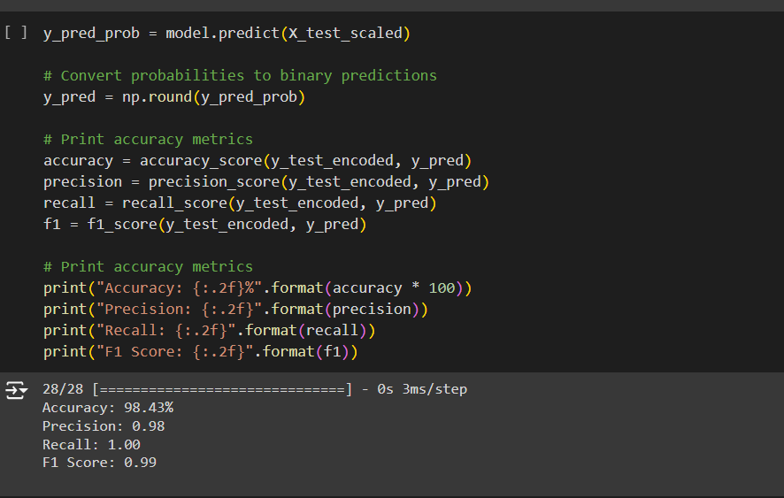
Evaluation metrics of neural
network model

Slide 16


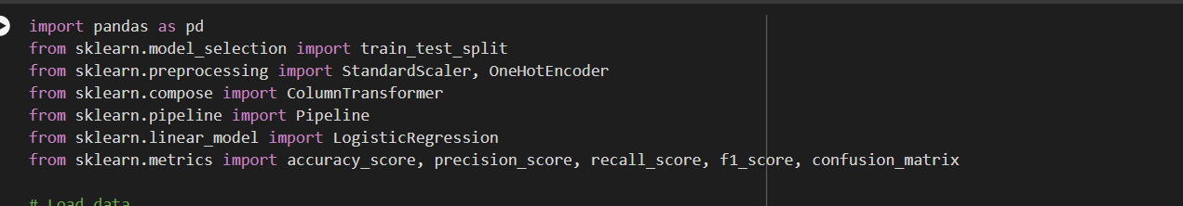
using logistic regression
import the required libraries

Slide 17
convert the fraud indicator into binary representation (Fraud-1,Not fraud-0)

Slide 18


identify the categorical and numerical values
categorical_features = ['Vehicle_Dimensions','Vehicle_Type', 'FastagID', 'TollBoothID',
'Lane_Type', 'Geographical_Location', 'Vehicle_Plate_Number']
numerical_features = [ 'Transaction_Amount', 'Amount_paid', 'Vehicle_Speed']
categorical->non-numeric

Slide 19
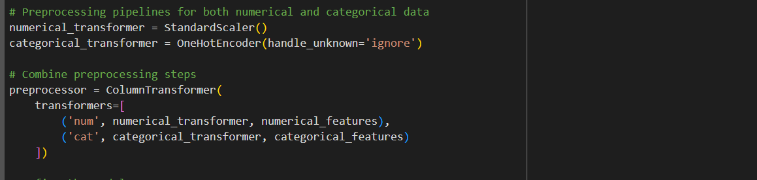

Slide 20
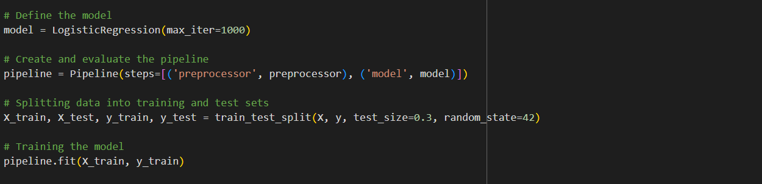

Slide 21
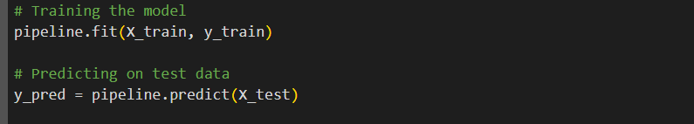
Predicting on test data using the model

Slide 22
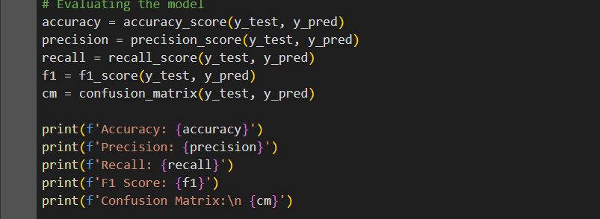
Evaluation metrics of Logistic Regression model

Slide 23
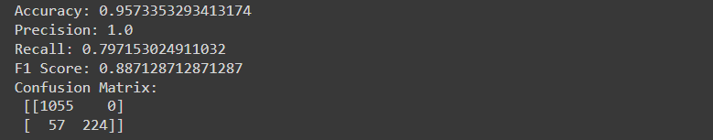

Slide 24
Real time fraud detection
It is the process of identifying and preventing the fraudulent activities as they occur in a timely manner.
The goal is to detect the fraud efficiently and in less time to minimize the financial losses.

Slide 25
exploratory
analysis
It involves the exploring and understanding the given data to gain insights into patterns. It explains the underlying structure ans characteristics of data
-----0-----0----0-----
-----0-----0--
----0---
---0--

Slide 26


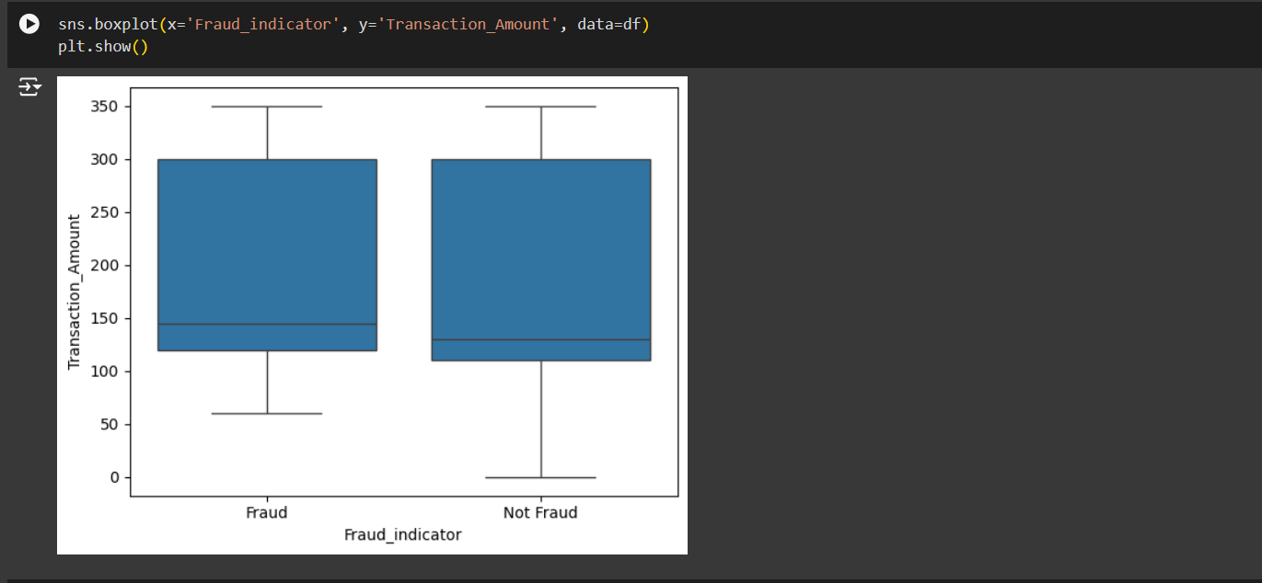
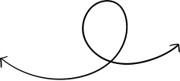
showing the box plot between the fraud indicator and transaction amount

Slide 27


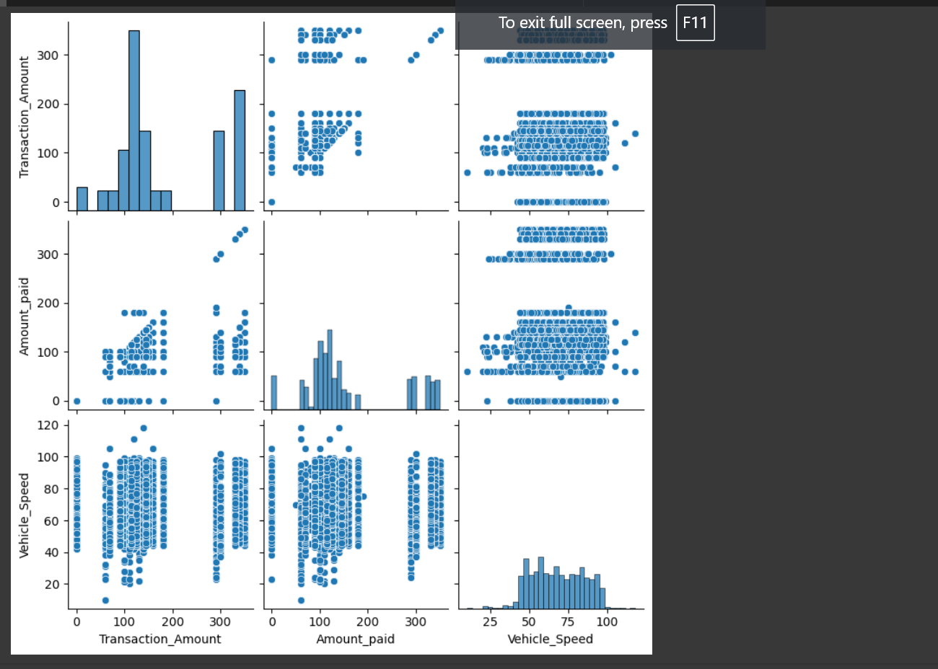
showing the dependence of some features on one another

Slide 28


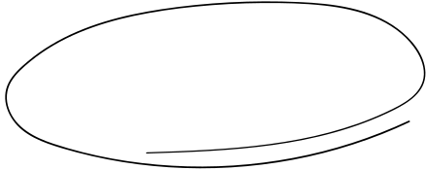
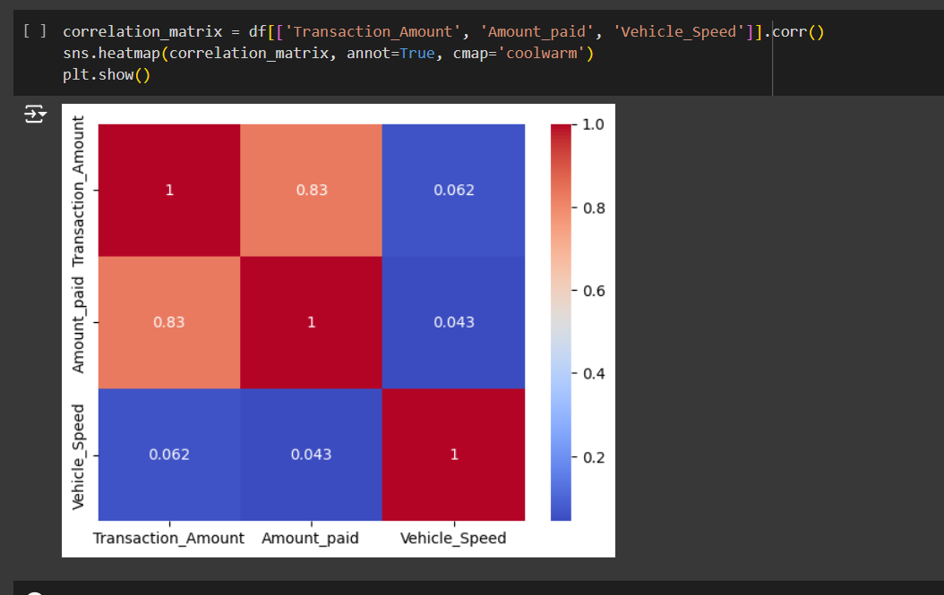

dependency in the form of correlation matrix

Slide 29







